Slide 1
Finding the Subnet, Broadcast and Useable Host Ranges
Lecture 12
Topic: Error Control in TCP

Slide 2
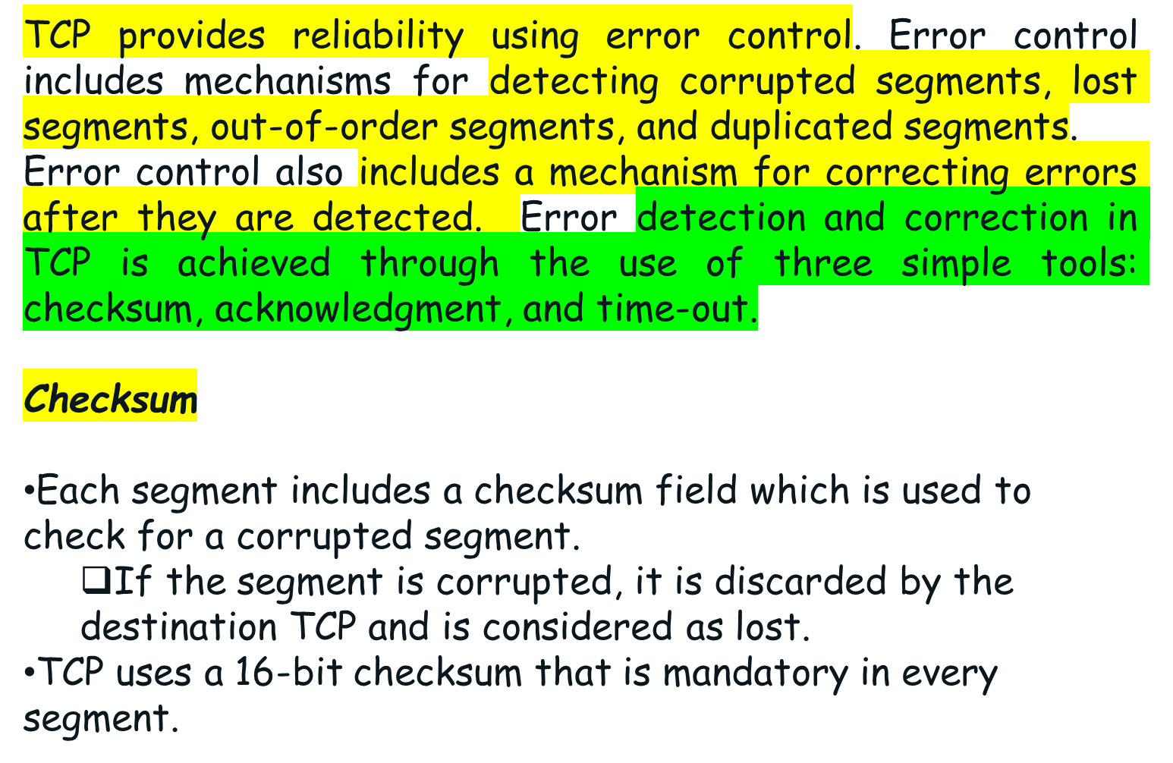
Introduction

Slide 3
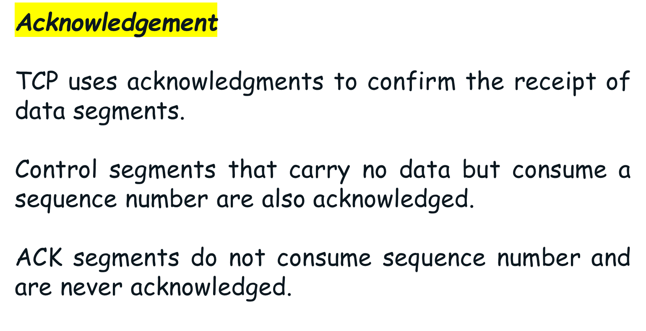
Cont.

Slide 4
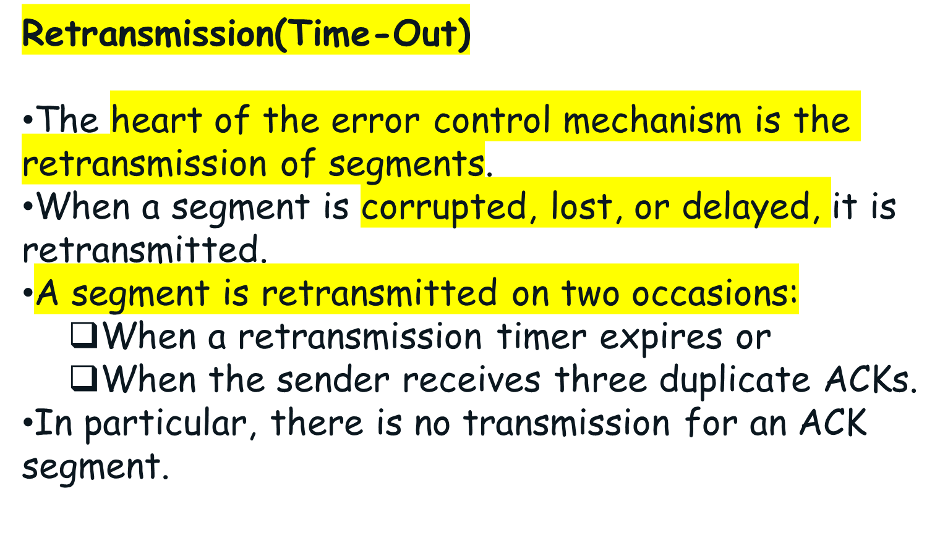
Cont.

Slide 5
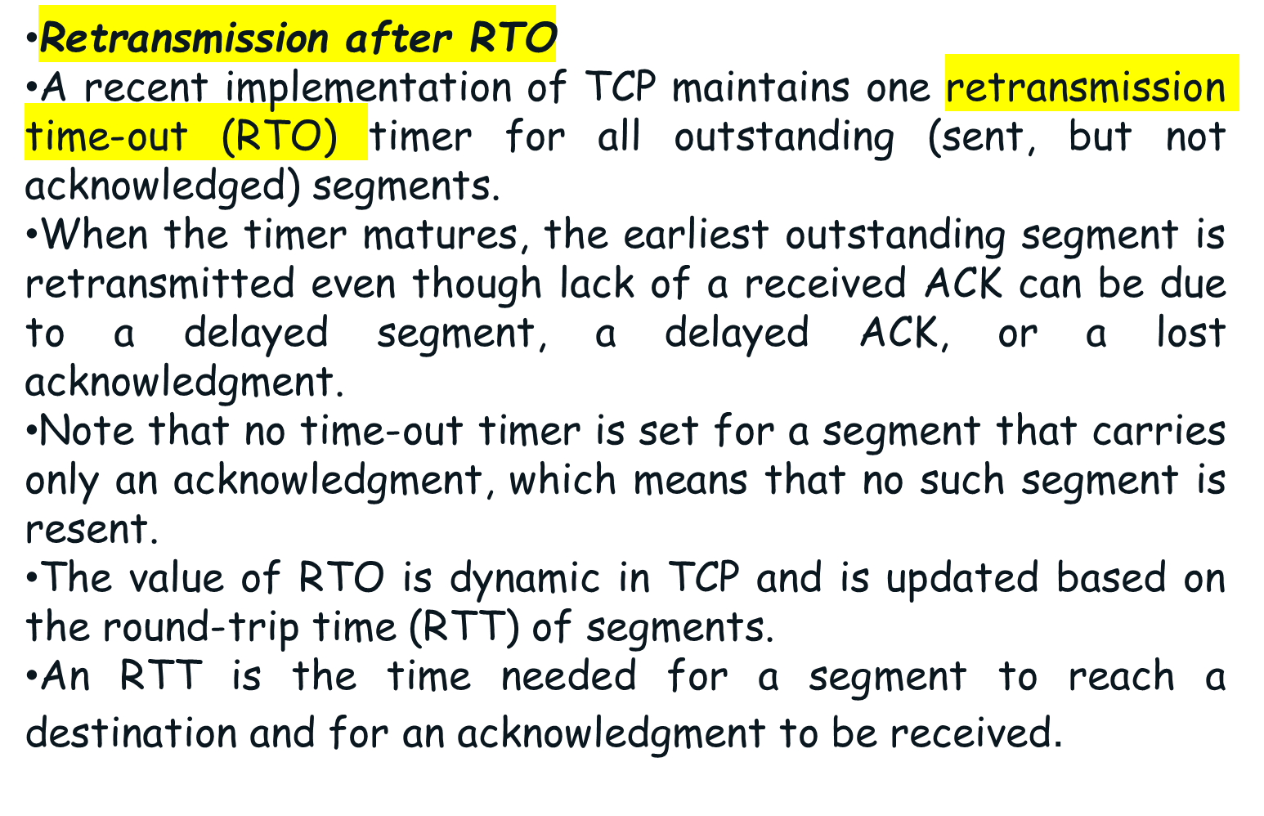
Cont.

Slide 6
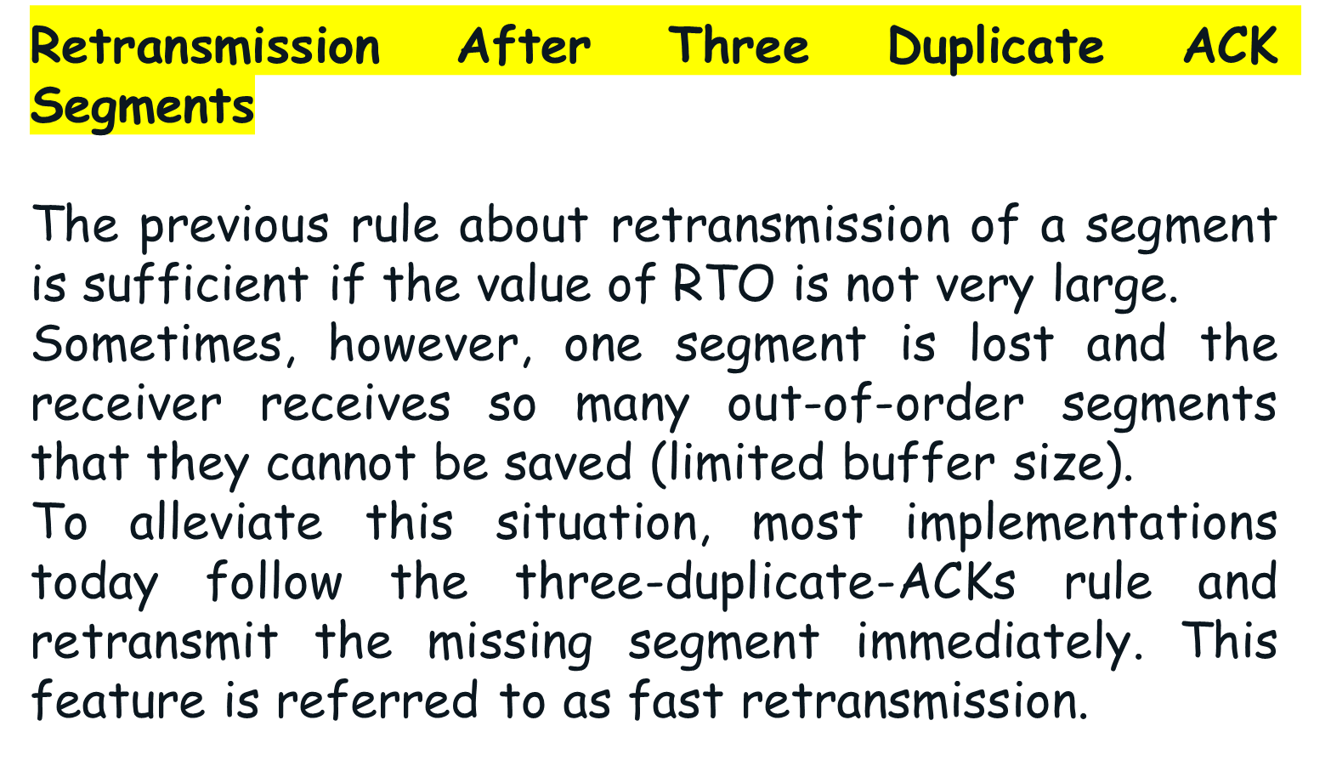
Cont.

Slide 7
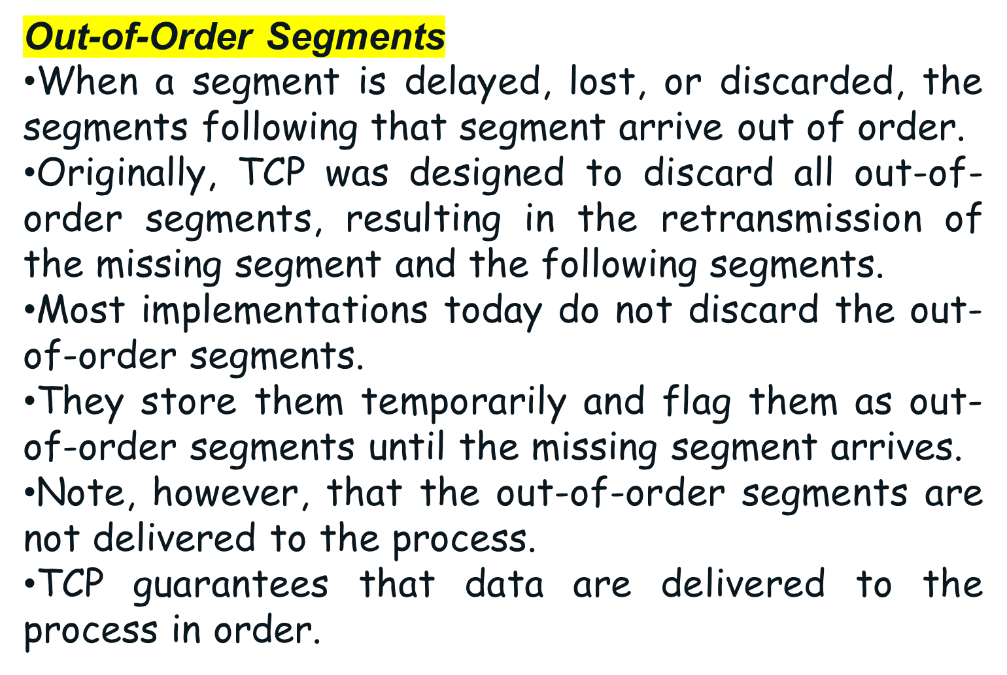
Cont.

Slide 8

Some Scenario-Normal Operation

Slide 9
Normal Operation-Cont.
The first scenario shows bidirectional data transfer between two systems.
The client TCP sends one segment; the server TCP sends three.
The figure shows which rule applies to each acknowledgment.
There are data to be sent, so the segment displays the next byte expected.
When the client receives the first segment from the server, it does not have any more data to send; it sends only an ACK segment.

Slide 10

Normal Operation-Cont.
However, the acknowledgment needs to be delayed for 500 ms to see if any more segments arrive. When the timer matures, it triggers an acknowledgment.
This is so because the client has no knowledge if other segments are coming; it cannot delay the acknowledgment forever.
When the next segment arrives, another acknowledgment timer is set. However, before it matures, the third segment arrives.
The arrival of the third segment triggers another acknowledgment.

Slide 11

A lost segment and a corrupted segment are treated the same way by the receiver.
A lost segment is discarded somewhere in the network; a corrupted segment is discarded by the receiver itself. Both are considered lost.

Slide 12


